Slide 2
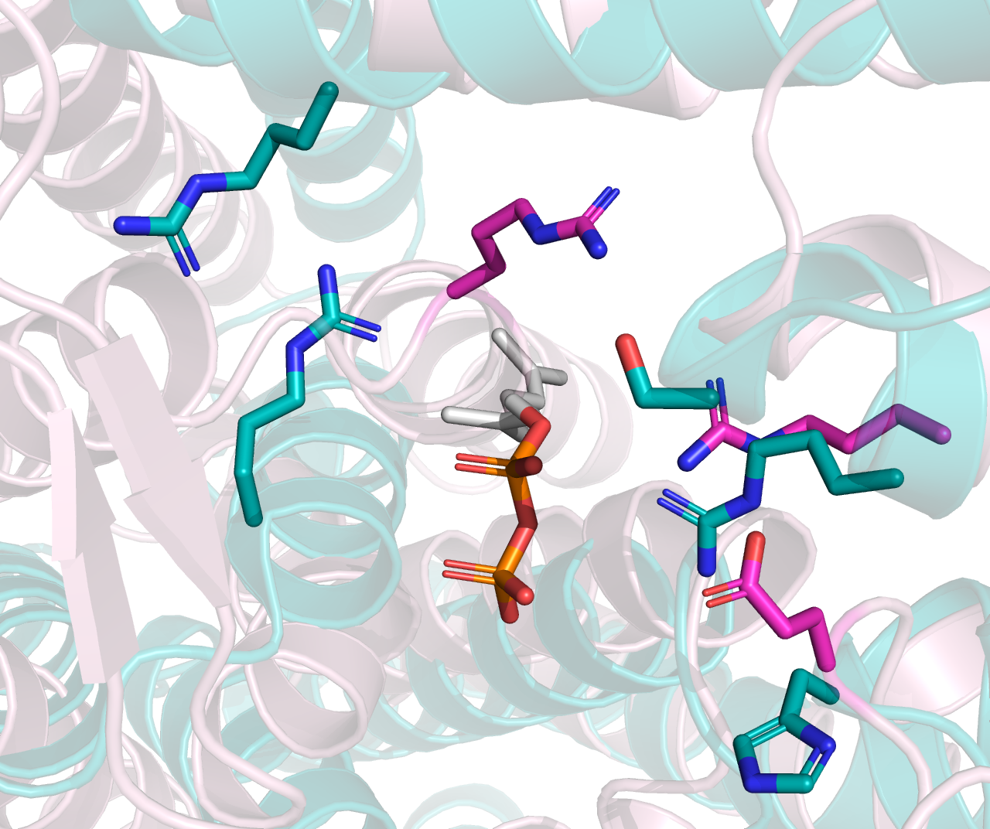
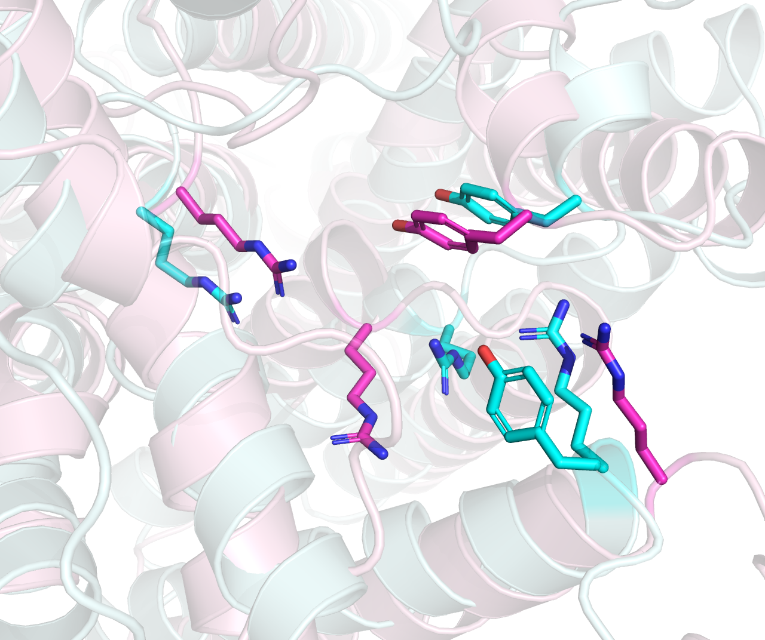
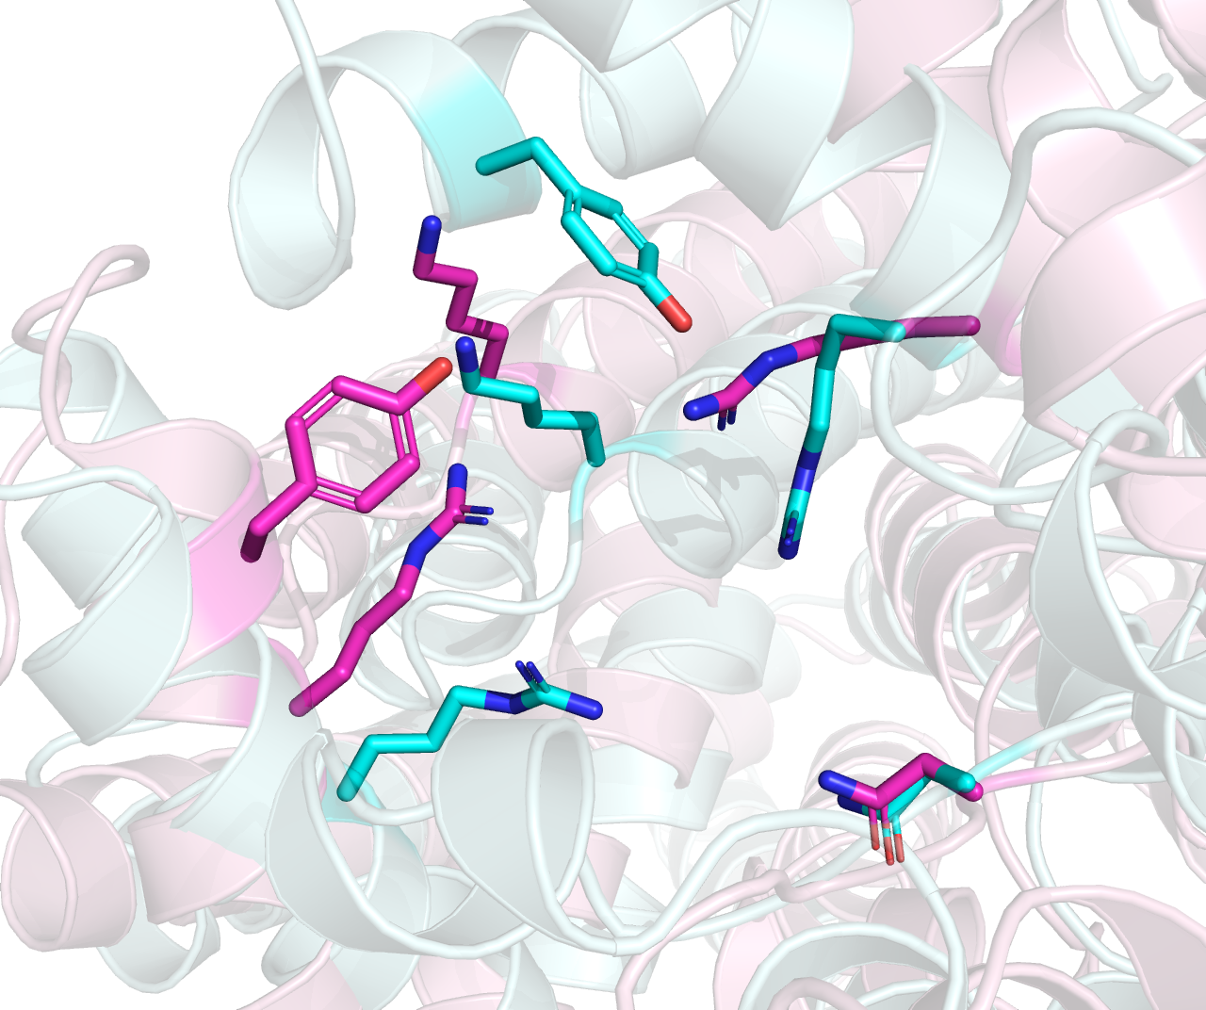
Cyan: 615, O-Lig. Pink: 614, O-Pol
Cyan: 586, ECA-Pol. Pink: 608, O-Pol
Cyan: 606, O-Pol. Pink: 611, O-Pol

Slide 3
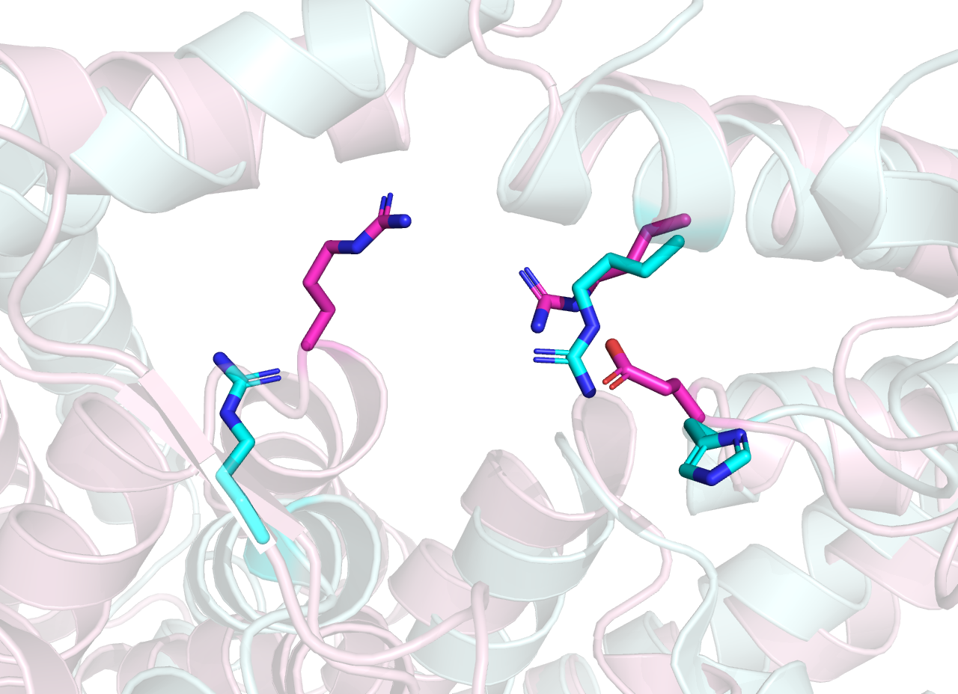
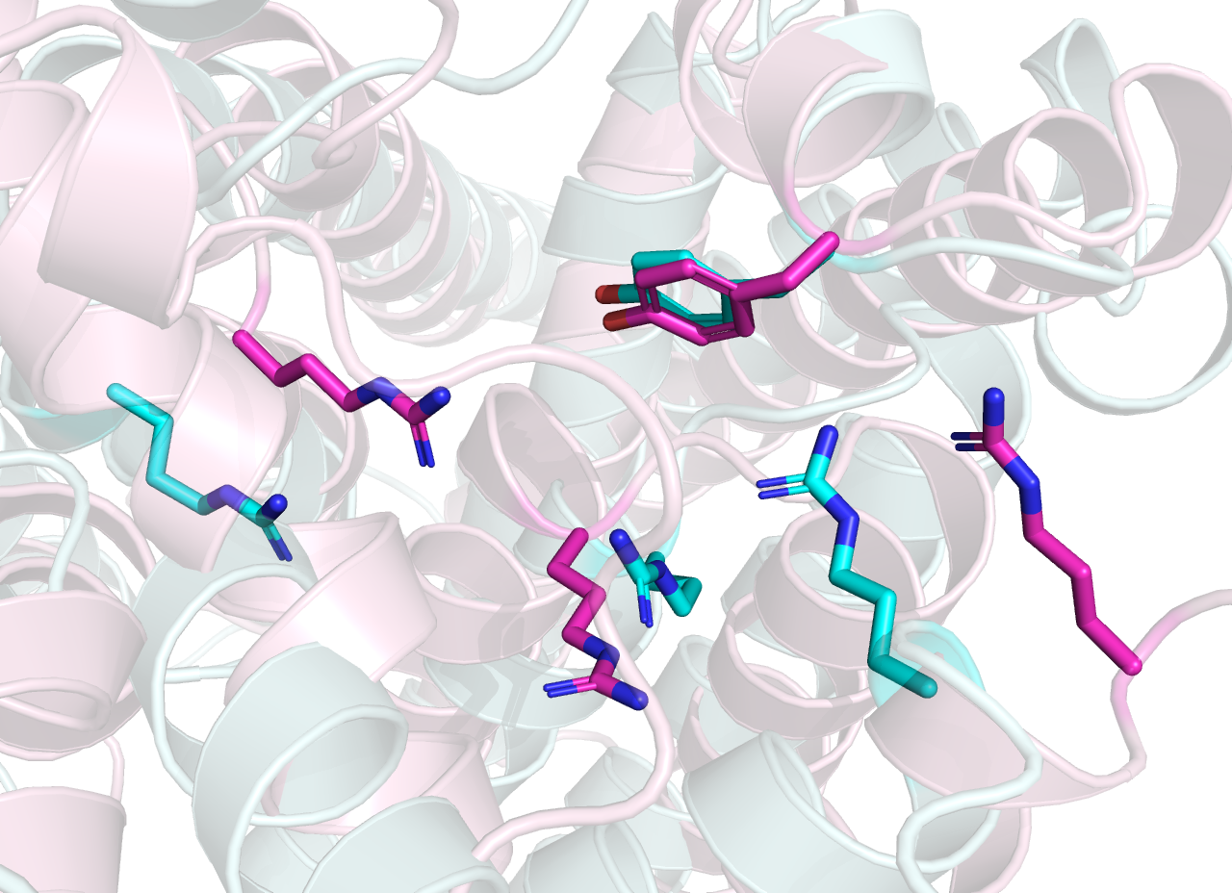
Cyan: 615, O-Lig (7TPG). Pink: 614, O-Pol
Cyan: 586, ECA-Pol. Pink: 608, O-Pol

